Slide 1

Sreyas Institute of Engineering and Technology
An Autonomous Institution
Approved by AICTE, Affiliated to JNTUH
Accredited by NAAC-A Grade, NBA (CSE, ECE & ME) & ISO 9001:2015 Certified
A
PROJECT
On
JARVIS: A Portable AI Assistant
COMPUTER SCIENCE AND ENGINEERING(CSE-C)
BY
V VARUN 22VE1A05J8
B LAVANYA 23VE5A0516
C UDAY 23VE5A0517
N SHILPA 23VE5A0520
ACADEMIC BATCH: (2022-2026)

Slide 2
Abstract
This project presents JARVIS: A Portable AI Assistant, a lightweight voice-controlled system designed to run directly from a USB pen drive across multiple platforms including Windows. The assistant combines both offline and online capabilities, enabling users to perform everyday tasks such as file management, media control, document reading, message replies, and intelligent web-based information retrieval. JARVIS utilizes speech recognition and text-to-speech technologies to enable natural human–computer interaction through voice commands. The system continuously listens for predefined wake words while running silently in the background, ensuring hands-free operation. Its conversational AI model provides real-time responses and task execution without requiring extensive setup on host systems. The portability, platform independence, and autonomous functioning of JARVIS make it an innovative and practical solution for personalized digital assistance, inspired by the concept of Iron Man’s intelligent assistant.
Keywords— Portable AI Assistant, Voice Recognition, Speech-to-Text, Text-to-Speech, Cross-Platform Application, USB-Based Computing, Conversational AI, Virtual Assistant, Natural Language Processing, Task Automation.

Slide 3
Existing System
Common AI assistants: Cortana, Siri, Google Assistant, Alexa.
Mostly cloud-based and require constant internet connectivity.
Tied to specific platforms
(e.g., Siri → iOS, Cortana → Windows).
Require installation or hardware dependency.
Cannot be executed directly from external storage.
Limited personalization and system-level control.

Slide 4
Limitations of Existing System
Lack of offline functionality.
High dependency on the internet and cloud services.
Platform restrictions — not cross-compatible.
Cannot run directly from portable devices like USB drives.
Privacy concerns due to continuous online data exchange.
Limited user control over assistant’s functionality.

Slide 5
Proposed System
Introduces JARVIS, a fully portable AI assistant running from a pen drive.
Provides cross-platform support (Windows, Linux, macOS).
Includes offline command processing and online smart responses.
Uses Speech Recognition for voice input and TTS for output.
Remains hidden and listens for trigger words like “Hey Jarvis”.
Can perform tasks like:
Reading documents aloud.
Sending or replying to messages.
Opening files, folders, and applications.
Fetching AI-based answers using local or cloud models.

Slide 6
Merits of Proposed System
Portable and Plug-and-Play — runs directly from a USB drive.
Cross-Platform Compatibility — works on any OS.
Offline + Online Hybrid Mode ensures uninterrupted performance.
Enhanced Privacy — minimal data sharing.
User-Friendly Interface with natural voice conversation.
Customizable Commands and modular structure.
No Installation Required — truly autonomous.

Slide 7
Software and Hardware Requirements
Software :
Programming Language: Python
Libraries: speech recognition, pyttsx3, openai, os, tkinter, pyaudio
IDE: VS Code / PyCharm
Operating Systems: Windows, Linux, macOS
Additional Tools: Offline speech models, TTS engine, File handling modules
Hardware :
USB Pen-drive (minimum 8 GB)
Computer with microphone and speakers
4 GB RAM or higher
Dual-core processor
Internet (only for online AI mode)

Slide 8
Functional and Non-Functional Requirements
Functional :
Recognize voice commands.
Execute system-level tasks (open files, control volume, etc.).
Respond using speech output.
Switch between offline and online modes.
Stay active in the background until trigger word detected.
Non-Functional :
Portability: Should execute from any USB drive.
Usability: Simple and user-friendly voice interface.
Performance: Quick response time (< 3 seconds).
Reliability: Stable across platforms.
Security: Minimal data storage; privacy-focused.

Slide 9
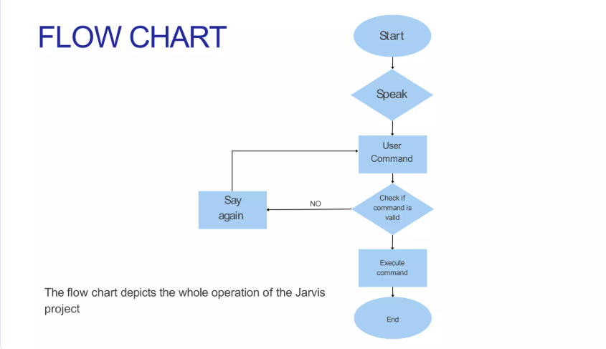
ARCHITECTURE

Slide 10
MODULES
Voice Interaction Module Voice Out
Command Processing Module
AI Intelligence Module
System Automation Module
File & Media Management Module
Portability & Deployment Module

Slide 11






MODULES USED
1
4
Voice Interaction Module
Captures user voice commands using microphone
Converts speech to text and text back to speech
Enables hands-free interaction using a trigger word
Command Processing Module
Analyzes user commands
Identifies whether the request is system-related
Routes commands to appropriate module
AI Intelligence Module
Handles intelligent question answering
Uses online AI model when internet is available
Provides human-like responses
System Automation Module
Performs tasks like opening applications, web
Executes OS-level operations smoothly
Works silently in background
File & Media Management Module
Accesses files stored on USB or system
Opens documents, images, audio, and video
Supports safe deletion and file operations
Portability & Deployment Module
Runs directly from USB pen drive
No installation required on host system
Works across Windows, Linux, and macOS
2
5
3
6

Slide 12
Class Diagram
python.pyttsx3
init ()
getProperty()
setProperty()
python.pypiwin32
python.datatime
python.speech.recognintion
datetime.now()
Controller
recognizer()
listen()
speak()
wishme()
takeCOmmand()
sendEmail()
python.wikipedia
python.webbrowser
summary()
takeCommand()
open()
pyhton.smtplib
python.os
SMTP()
ehlo()
startls()
login()
close()
listDir()
startFile()

Slide 13
Use Case Diagram
Start
Listening for Wake Word
User Input Detected
(Voice Command)
Process Voice Input
(Speech-to-Text & NLU)
Yes ( Error)
No (Unknown/Error)
Intent
Identified?
Generate Error Response
Yes (Action/Query)
Execute Device Action(IOT)
Retrieve Information (web/DB)
Generate Natural Language Response
(Text-to-Speech)
End

Slide 14
Activity Diagram
start
Initialize JARVIS System
Activate Passive Listening Mode
Detect Wake Word
Wake Word Detected?
Continue Listing
Capture User Voice Command
Convert Speech to the Command
Convert Speech to Text
Offline Task
Online Task
Internet Search
Fetch Web Information
Internet Search
Fetch Web Information
Type of Task?
File Management
Open Programs
Control Media
Generate Response Text
Access Web API
Execute System Command
Wait for Next Wake Mode
End / Wait for next Wake Word

Slide 15
Testing
Testing is a critical process to ensure software quality and reliability. It involves evaluating a system or its components with the aim of discovering defects and verifying that it meets specified requirements.
Types of Testing
Unit Testing
Focuses on individual components or functions in isolation.
Integration Testing
Verifies the interaction between different units or modules.
System Testing
Evaluates the complete and integrated software product.
Acceptance Testing
Confirms if the system meets business requirements and is ready for delivery.

Slide 16
Key Test Cases for Jarvis
A thorough testing approach guarantees Jarvis performs optimally across various scenarios,
providing a reliable and intuitive user experience.
TC_001
Voice command for setting a reminder: "Jarvis, remind me to call John at 3 PM tomorrow."
Jarvis acknowledges and sets the reminder accurately for the specified date and time.
Pass
Query for current weather in a specific city: "Jarvis, what's the weather like in Mumbai?"
Jarvis provides the accurate current weather conditions and forecast for Mumbai.
Pass
TC_002
TC_003
Playing music from a linked streaming service: "Jarvis, play my workout playlist."
Jarvis initiates playback of the specified playlist from the connected streaming service.
Pass
TC_004
Performing a simple calculation: "Jarvis, what is 15 multiplied by 8?"
Jarvis provides the correct mathematical answer (120).
Pass

Slide 17
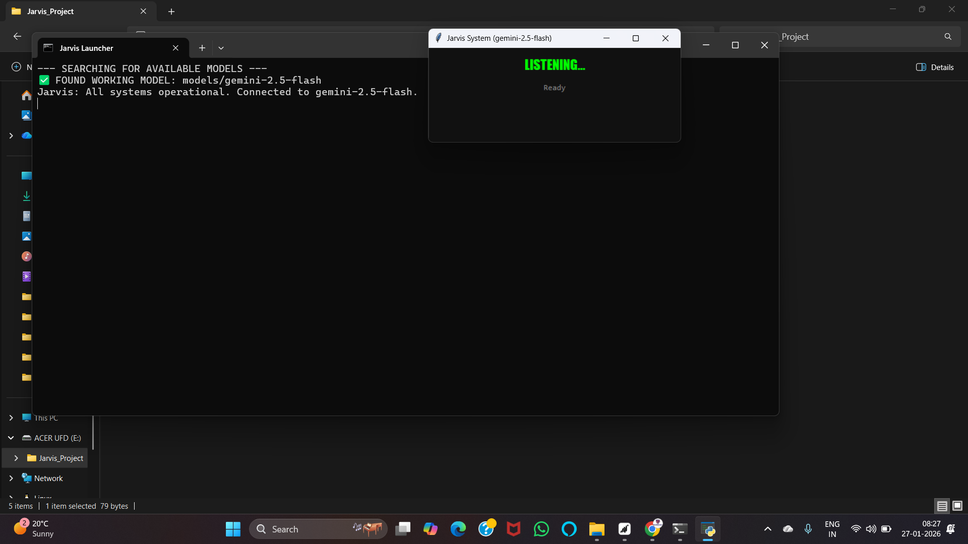
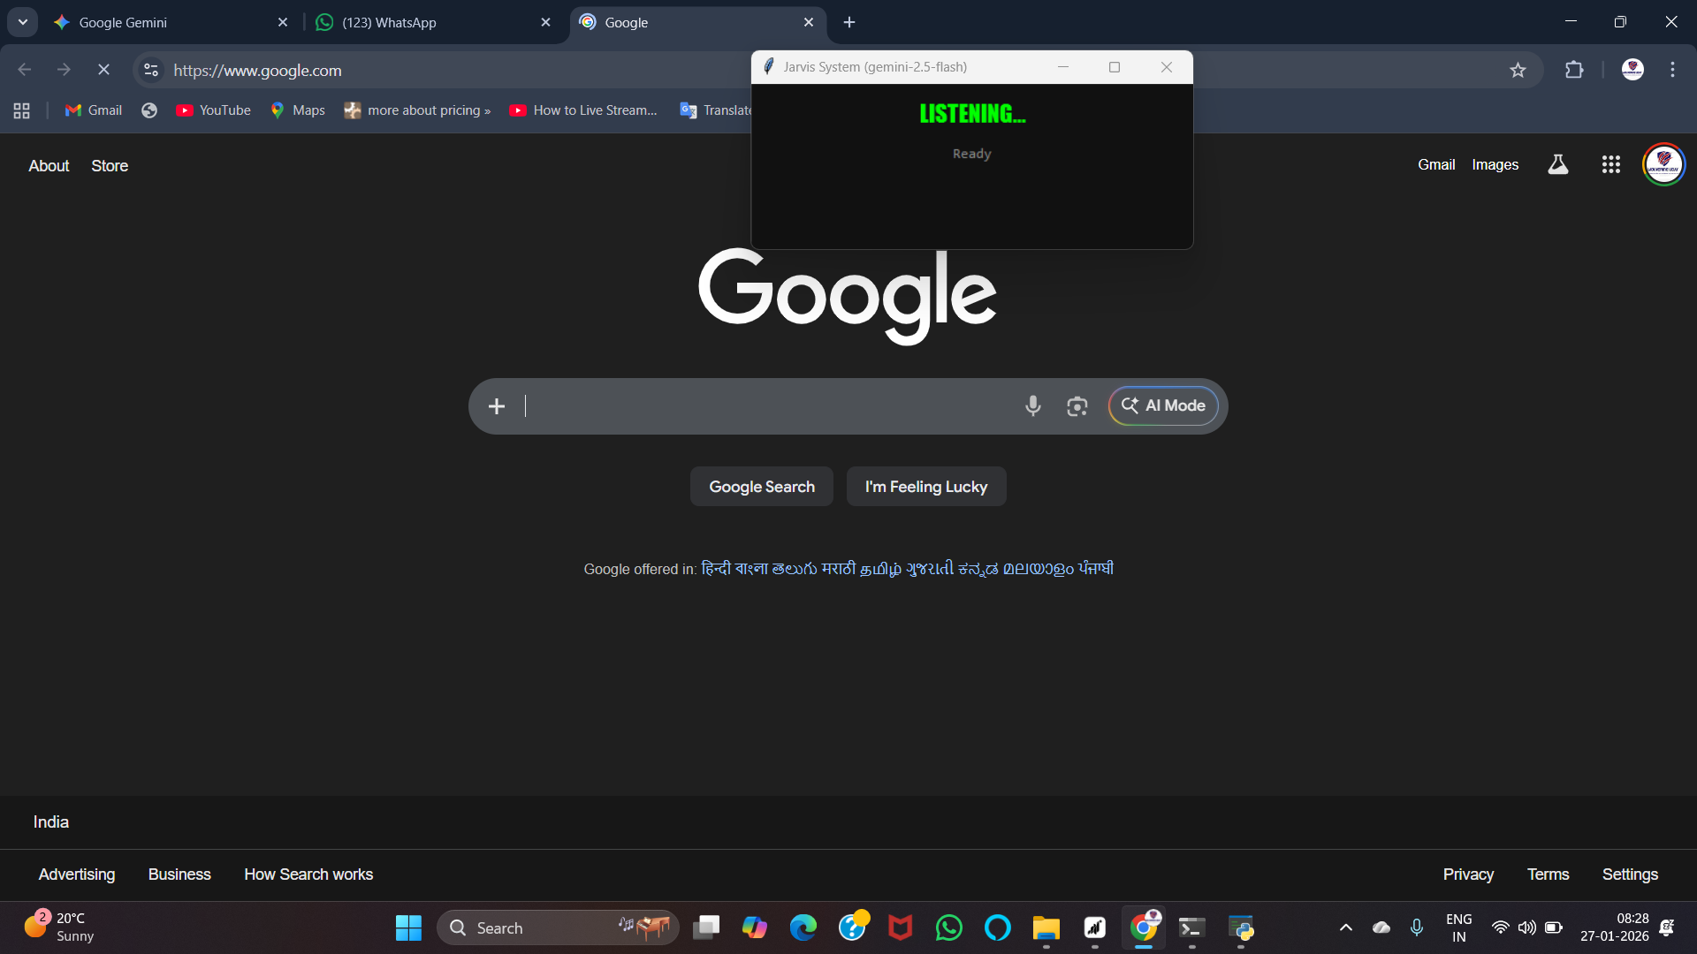
Output Screen Shots

Slide 18
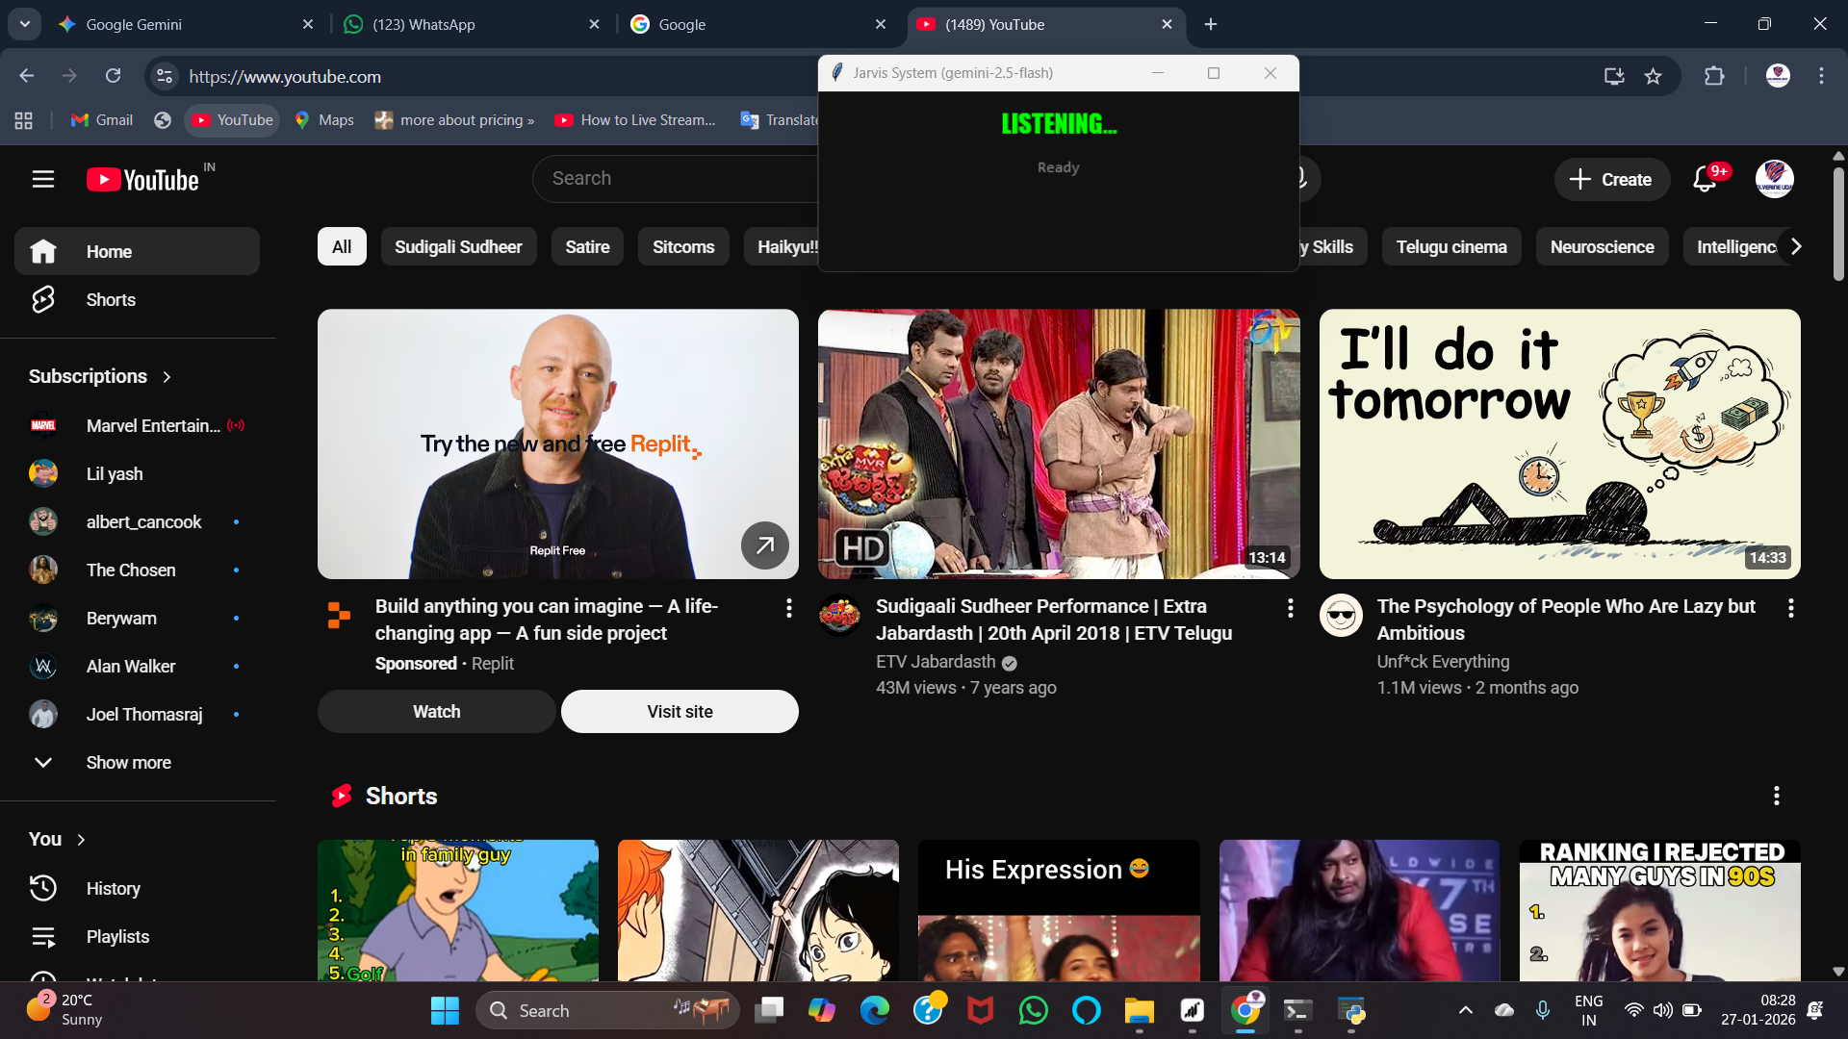
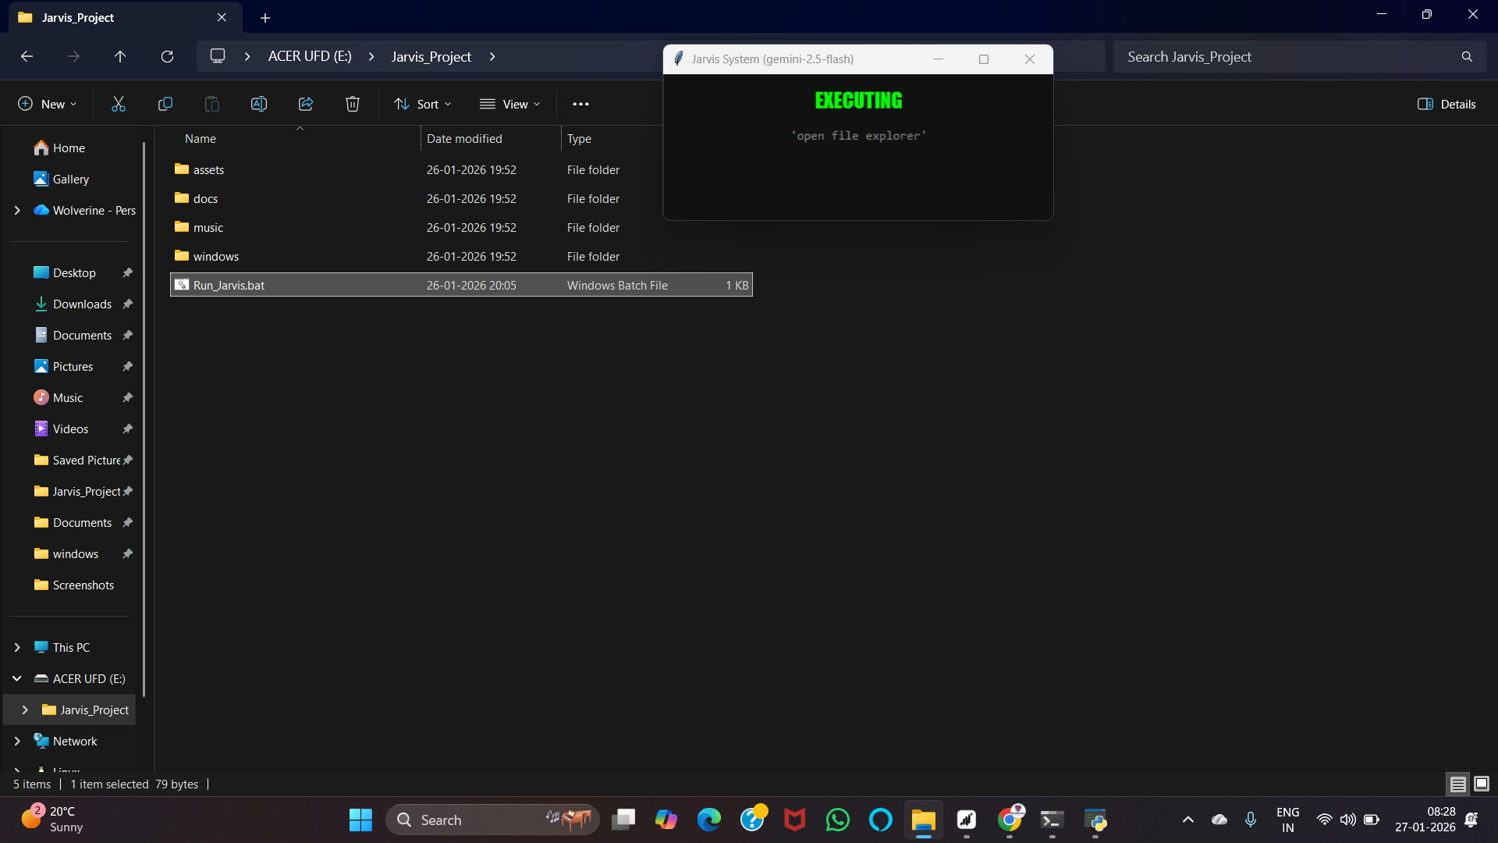
Output Screen Shots

Slide 19
Limitations
While Jarvis offers advanced capabilities, certain limitations were identified during its initial development phase.
Offline Functionality
Complex Queries
Limited functionality without an active internet connection, impacting real-time data access.
Challenges in processing highly nuanced or multi-part complex natural language queries effectively.
Device Compatibility
Privacy Concerns
Currently optimized for specific operating systems, with broader compatibility under development.
Ongoing efforts to enhance data privacy and user control over personal information.

Slide 20




Future Scope for Jarvis
The potential for Jarvis is vast, with exciting advancements planned to expand its utility and intelligence.
Advanced Learning
Multilingual Support
Implementation of deeper machine learning algorithms for more personalized interactions.
Expanding language capabilities to cater to a global
user base.
Smart Home Integration
Enhanced Security
Seamless control and management of various smart home devices and ecosystems.
Integration of biometric authentication for secure access and sensitive tasks.

Slide 21
CONCLUSION
The Jarvis Portable AI Assistant represents a significant advancement in personal automation technology, aimed at improving the efficiency and accessibility of digital interactions. By integrating live data sources—such as the Gemini AI engine, real-time web searching, and system-level hooks—this project transforms a standard computer into an intelligent, voice-responsive ecosystem. It enables hands-free operation, minimizes the time spent on repetitive manual tasks, and provides a sophisticated "Iron Man" inspired user experience. This not only enhances user productivity but also demonstrates the power of combining local Python scripts with cloud-based intelligence. However, implementing such a sophisticated system comes with its own set of challenges. Real-time Speech-to-Text (STT) and high-level reasoning require stable internet connectivity for API calls and consistent computational resources for audio processing. The accuracy of Jarvis’s responses depends heavily on the quality of the microphone input and the clarity of the Large Language Model’s output. Additionally, the system must continuously adapt to dynamic environments, such as varying background noise levels or different hardware configurations on a guest host. Despite these limitations, the benefits of improved workflow, portability via USB, and personalized interaction make Jarvis a valuable tool for modern digital life.

Slide 22
THANK YOU

